Slide 1
Electric and hybrid vehicles and challenges to road funding.
Dr. Adrian Moore
Vice President
Reason

Slide 2
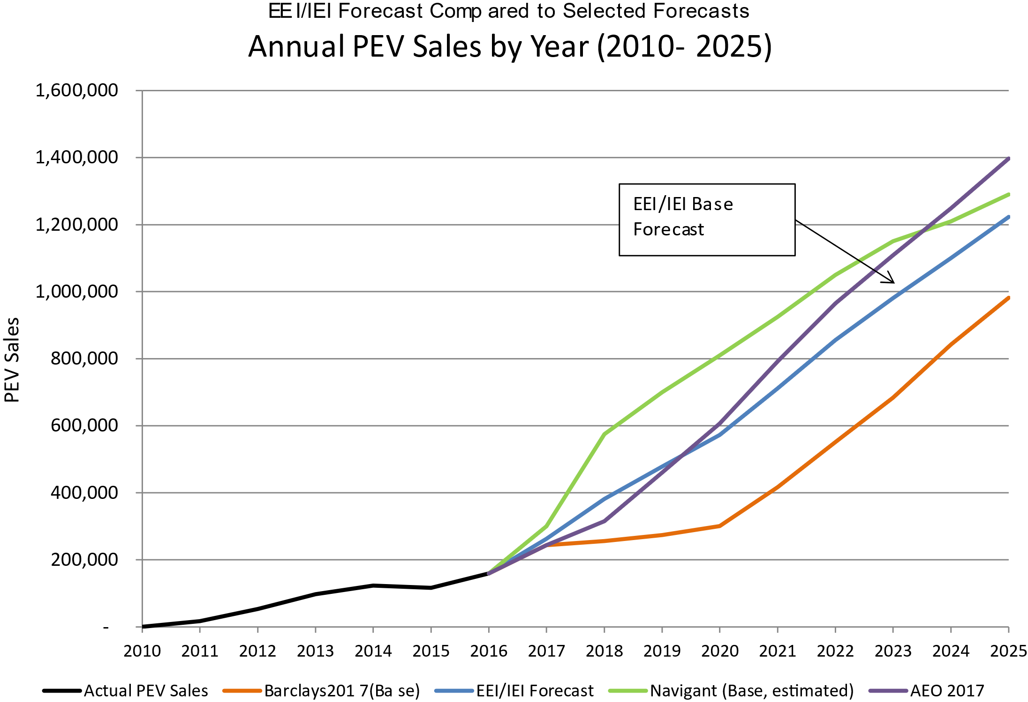

Slide 3
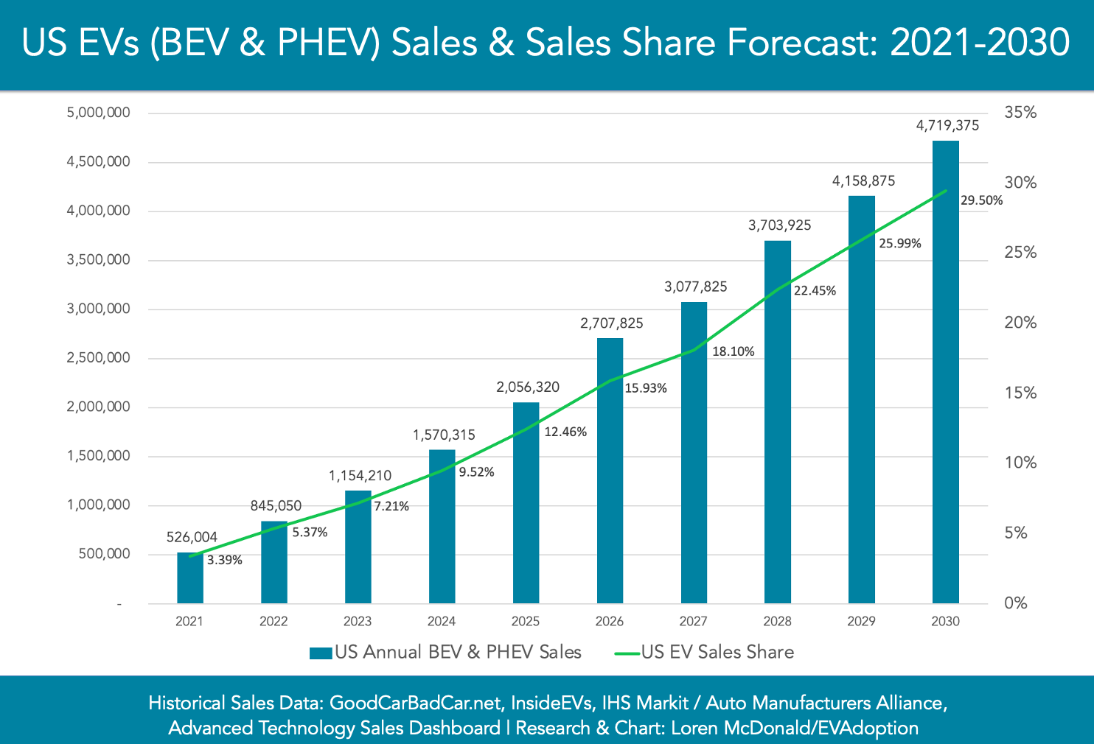

Slide 4
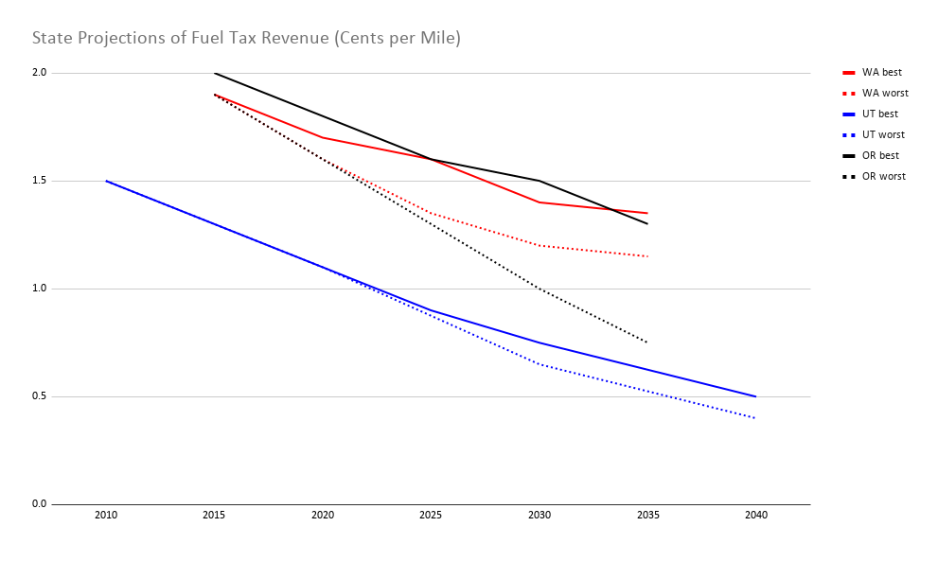
Fuel tax’s decline
US RUC Update

Slide 5
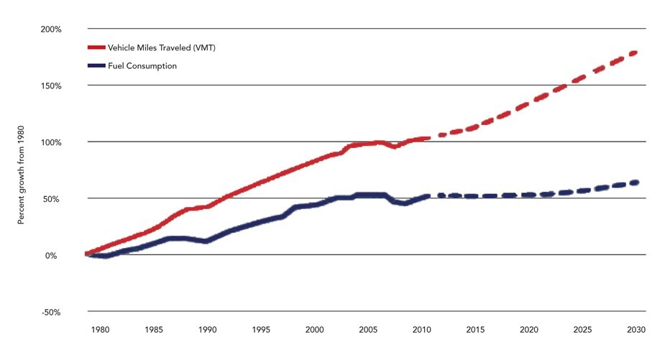
VMT vs Fuel Consumption Trend

Slide 6
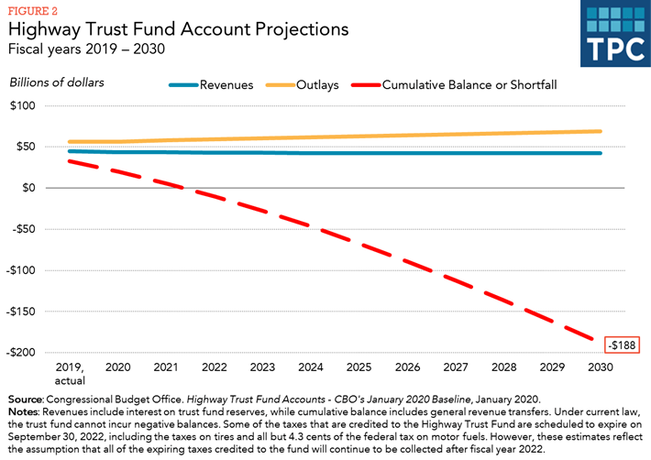

Slide 7
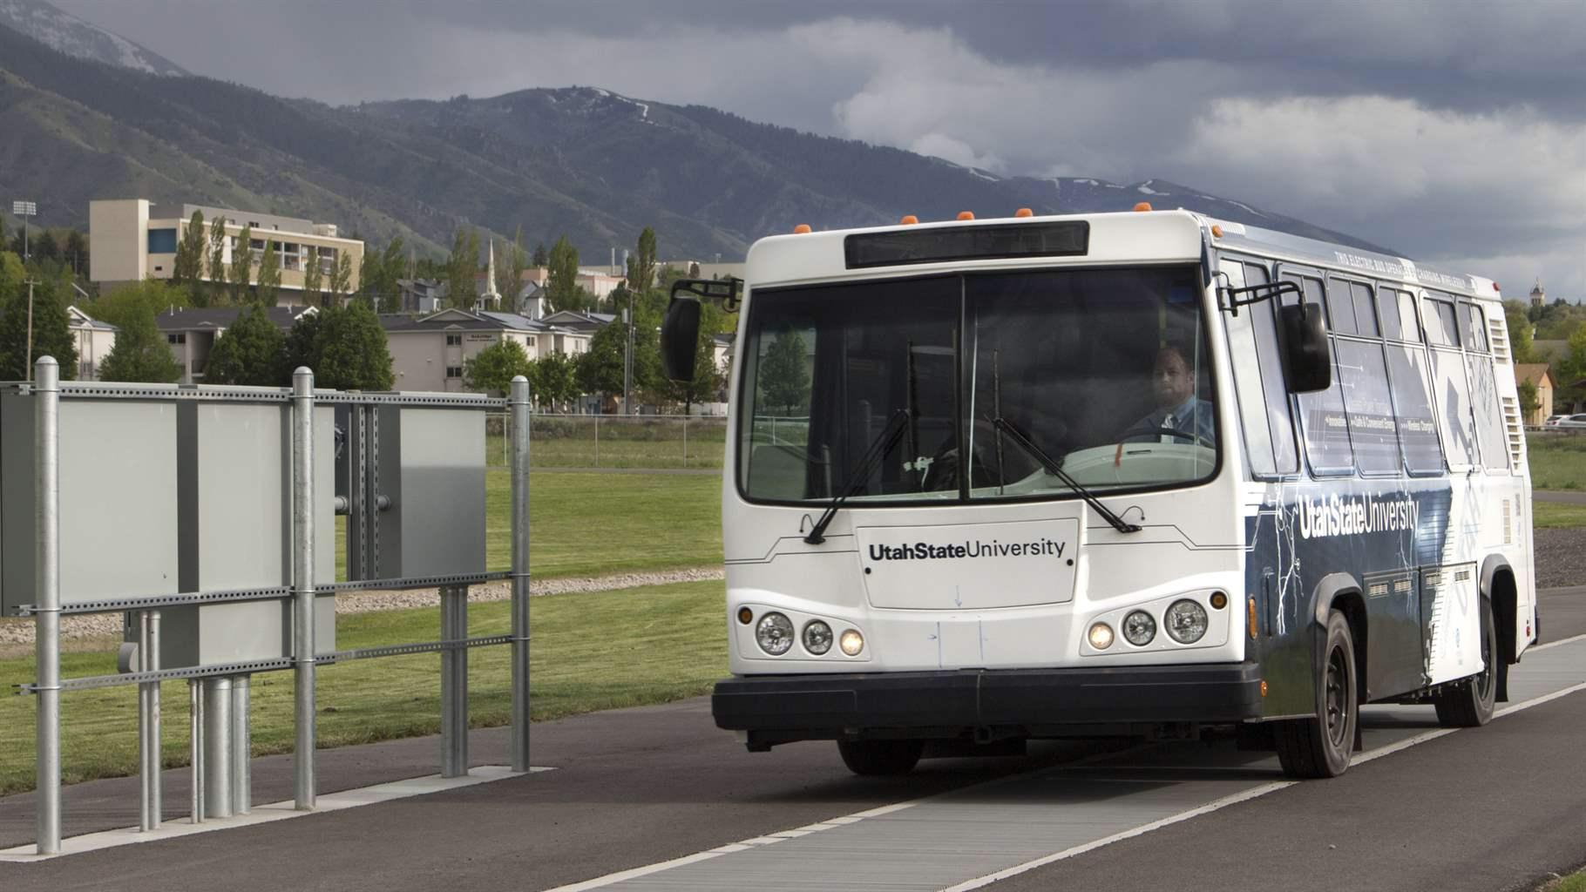
Fancy infrastructure?
A Utah State University electric bus outfitted for dynamic wireless charging passes over coils embedded in the pavement.

Slide 8
FAST Act Winners and Participants
WINNERS
Hawaii, Washington, Oregon, California, Colorado, Wyoming, Utah, Minnesota, Delaware, Ohio, Texas, Kansas, New Hampshire, Missouri
PARTICIPANTS
North Carolina, Pennsylvania, Virginia, New Jersey, Maine, Maryland and the District of Columbia
RUC West
I-95 Corridor Coalition

Slide 9
FAST Act and STSFA Grants
$95 million Surface Transportation System Funding Alternatives (STSFA) grant program established under the FAST Act
STSFA program purpose:
“to provide grants to States to demonstrate user-based alternative revenue mechanisms that utilize a user fee structure to maintain the long-term solvency of the Highway Trust Fund”

Slide 10
Key Context Issues
1. Mileage fees are a possibility, one being tested, not a policy being implemented.
2. It is being tested
  14 states are piloting
  2 regional organization are doing multi-state pilots
  3 states are implementing it on a gradual basis
3. User fees are the best way to fund transportation
4. There is no transportation funding mechanism without tradeoffs.
5. If you are skeptical of the idea, pilots are the best way to prove you are right. If you are in favor of the idea, pilots are the best way to prove you are right.

Slide 11
A National Pilot??
INFRASTRUCTURE INVESTMENT AND JOBS ACT - H.R. 3684 as amended and passed by Senate in August
“Pilot program to demonstrate a national motor vehicle per-mile user fee to restore and maintain the long-term solvency of the Highway Trust Fund”
$50,000,000 over 5 years ($10 million in 2022, 2023, 2024, 2025, 2026). If not expended, available for section 3001 state grant program.
Notes:
Sample Text Slide

Slide 12
Key Elements
Creates Advisory Board to advise Secretary on advancing and implementing national pilot and on conducting public awareness campaign and requires the advisory board to provide a recommended approach for the national pilot within one year of the establishment of the board.
    Composition: State DOTs, Section 6020 grant recipient, trucking industry, data security experts, academics, consumer advocates, equity focused advocacy groups, owners of motor vehicle fleets, owners of toll facilities, tribal groups.
Methods allowed:
    On-board diagnostics (OBD-II)
    Smart phones
    Telemetric data collected by automakers
    Motor vehicle data from car insurance companies
    Motor vehicle data from fueling stations
    Data from states that received STSFA grants
Notes:
Sample Text Slide

Slide 13
Key Elements
Criteria
    Choice of reporting methods
    Volunteers from all 50 states, DC and Puerto Rico
    Equitable geographic distribution
    Commercial and passenger motor vehicles
    Federal grant recipient states
Participants will pay fees and be reimbursed.
DOT will conduct a public awareness campaign and will provide a report to Congress on the outcomes of the trial.
Notes:
Sample Text Slide

Slide 14
What Political Leaders Expect to Learn About
Progress is stalled, but assuming it resumes….
Equity
Privacy
Collection costs
Data Security
Scalability
Appropriate State vs Federal roles
It’s an ambitious list that will be difficult to adequately address.
Notes:
Sample Text Slide

Slide 15
Questions?
Notes:
There is a tension here.
--law enforcement!
--evolution of police role in justice system
--tension between dealing with criminals and protecting people vs. rights

